Slide 1
Creating a Sense of Urgency
Ty Duncan
Coordinator of Accountability and Compliance
@isntructionalle on Twitter
tduncan@esc17.net

Slide 2

USING #ESC17 and tag @Instructionalle

Slide 3
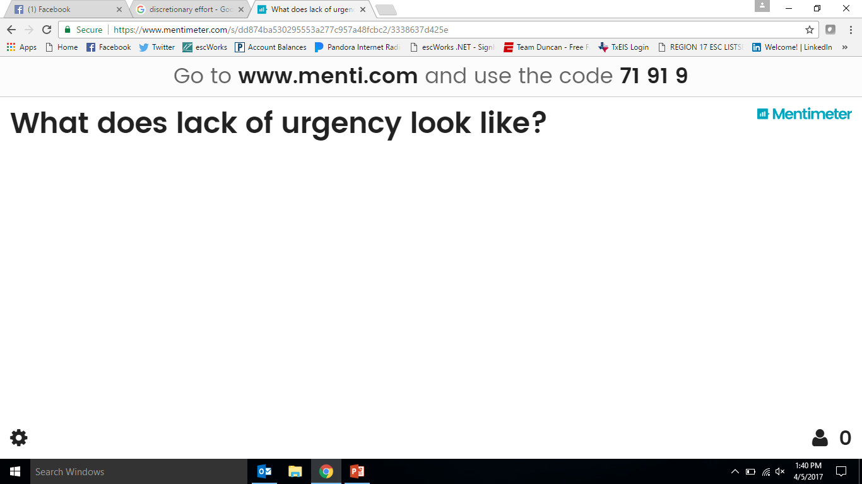

Slide 5


Building Blocks of School Culture
Notes:
12 Minutes

Slide 6
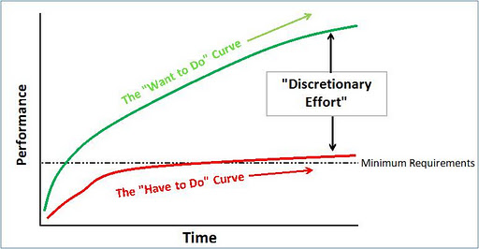

Slide 7
“A higher rate of urgency does not imply ever-present panic, anxiety, or fear. It means a state in which complacency is virtually absent.” - John P. Kotter

Slide 8
A Sense of Urgency!
Jamie Vollmer
No group of educators in the history of the world is expected to do what today’s educator are expected to do!
  http://www.taisresources.net/sense-of-urgency/

Slide 9

Creating a Sense Of Urgency!
Tactics from John Kotter!
Bring the Outside In!
Behave with Urgency Everyday!
Find Opportunity in Crisis
Deal with No No’s

Slide 10
Bring the Outside In!
Historical success can create complacency and a lack of looking outward for new ideas and research!
  One of the biggest reasons schools end up on a punitive list. They historically did fine in previous systems and never changed anything, but the calendar.
Do not shield people from troubling data!
  You will never turn anything around if the leader is the only one in the building who understands the breadth and depth of the problem and the stakes for not addressing them.
Keep the Moral Imperative in front of staff!
  Do you have the first six weeks of moral imperative quotes, stories, allegories, data point created and ready? Do one everyday of teacher professional development before school and one a week when school begins. Get on Twitter. They will jump out at you!

Slide 11
Behave with Urgency Everyday!
Is “Non-Urgency” a hidden norm of your culture?
  It manifests itself in PLCs with no outcomes and no follow up from leadership, meetings scheduled because a “boss” said you needed some, or picking PD in the summer because it fits into the vacation schedule, but has no potential to impact the real work we do.
Clear the Deck! Stop doing things that do not matter!
  Does your staff see you investing in things that have no impact on the trajectory of student achievement in the school. They will place their time in the same location.
Be Visible!
  Groundhog leaders create groundhog staff! “Hide and nobody will notice we are not making in an impact!”

Slide 12
Find Opportunity In Crisis
“Street Cred”?
  Can gain immense respect, loyalty, and influence when staff see a leader poised to lead with confidence during times of crisis!
Hide the Crisis Doesn’t Help!
  No need to overplay it to stakeholders, but underplaying it internally does not help urgency.
Follow these principles when in crisis!
  View it as an opportunity no matter how difficult
  Crisis does not automatically reduce complacency
  If you use it make sure it cannot be solved with simple actions!
  Focus on staff hearts as much as you do their minds! (Back to that morale imperative thing!)

Slide 13
Deal with No No’s
Skeptics are different than No No’s. Skeptics can be persuaded with data, however risk averse they may be. No No’s have 10 reasons why it will not work and know every conspiracy theory argument ever posted on the web about why education is doomed.
Immobilize them with social pressures!
  We probably cannot change their internal beliefs as they may be rooted in years of negativity and dissatisfaction they chose this profession, but we can….
    Ask everyone to share how their new teaching practice went with the whole staff!
    Define what No No’s look like without identifying names! (Ideal state idea)
    Publish clear data that change is working with kids.
Get Rid of Them!
  That is the hard one in our profession! Quality is often not lining up at the door!

Slide 14
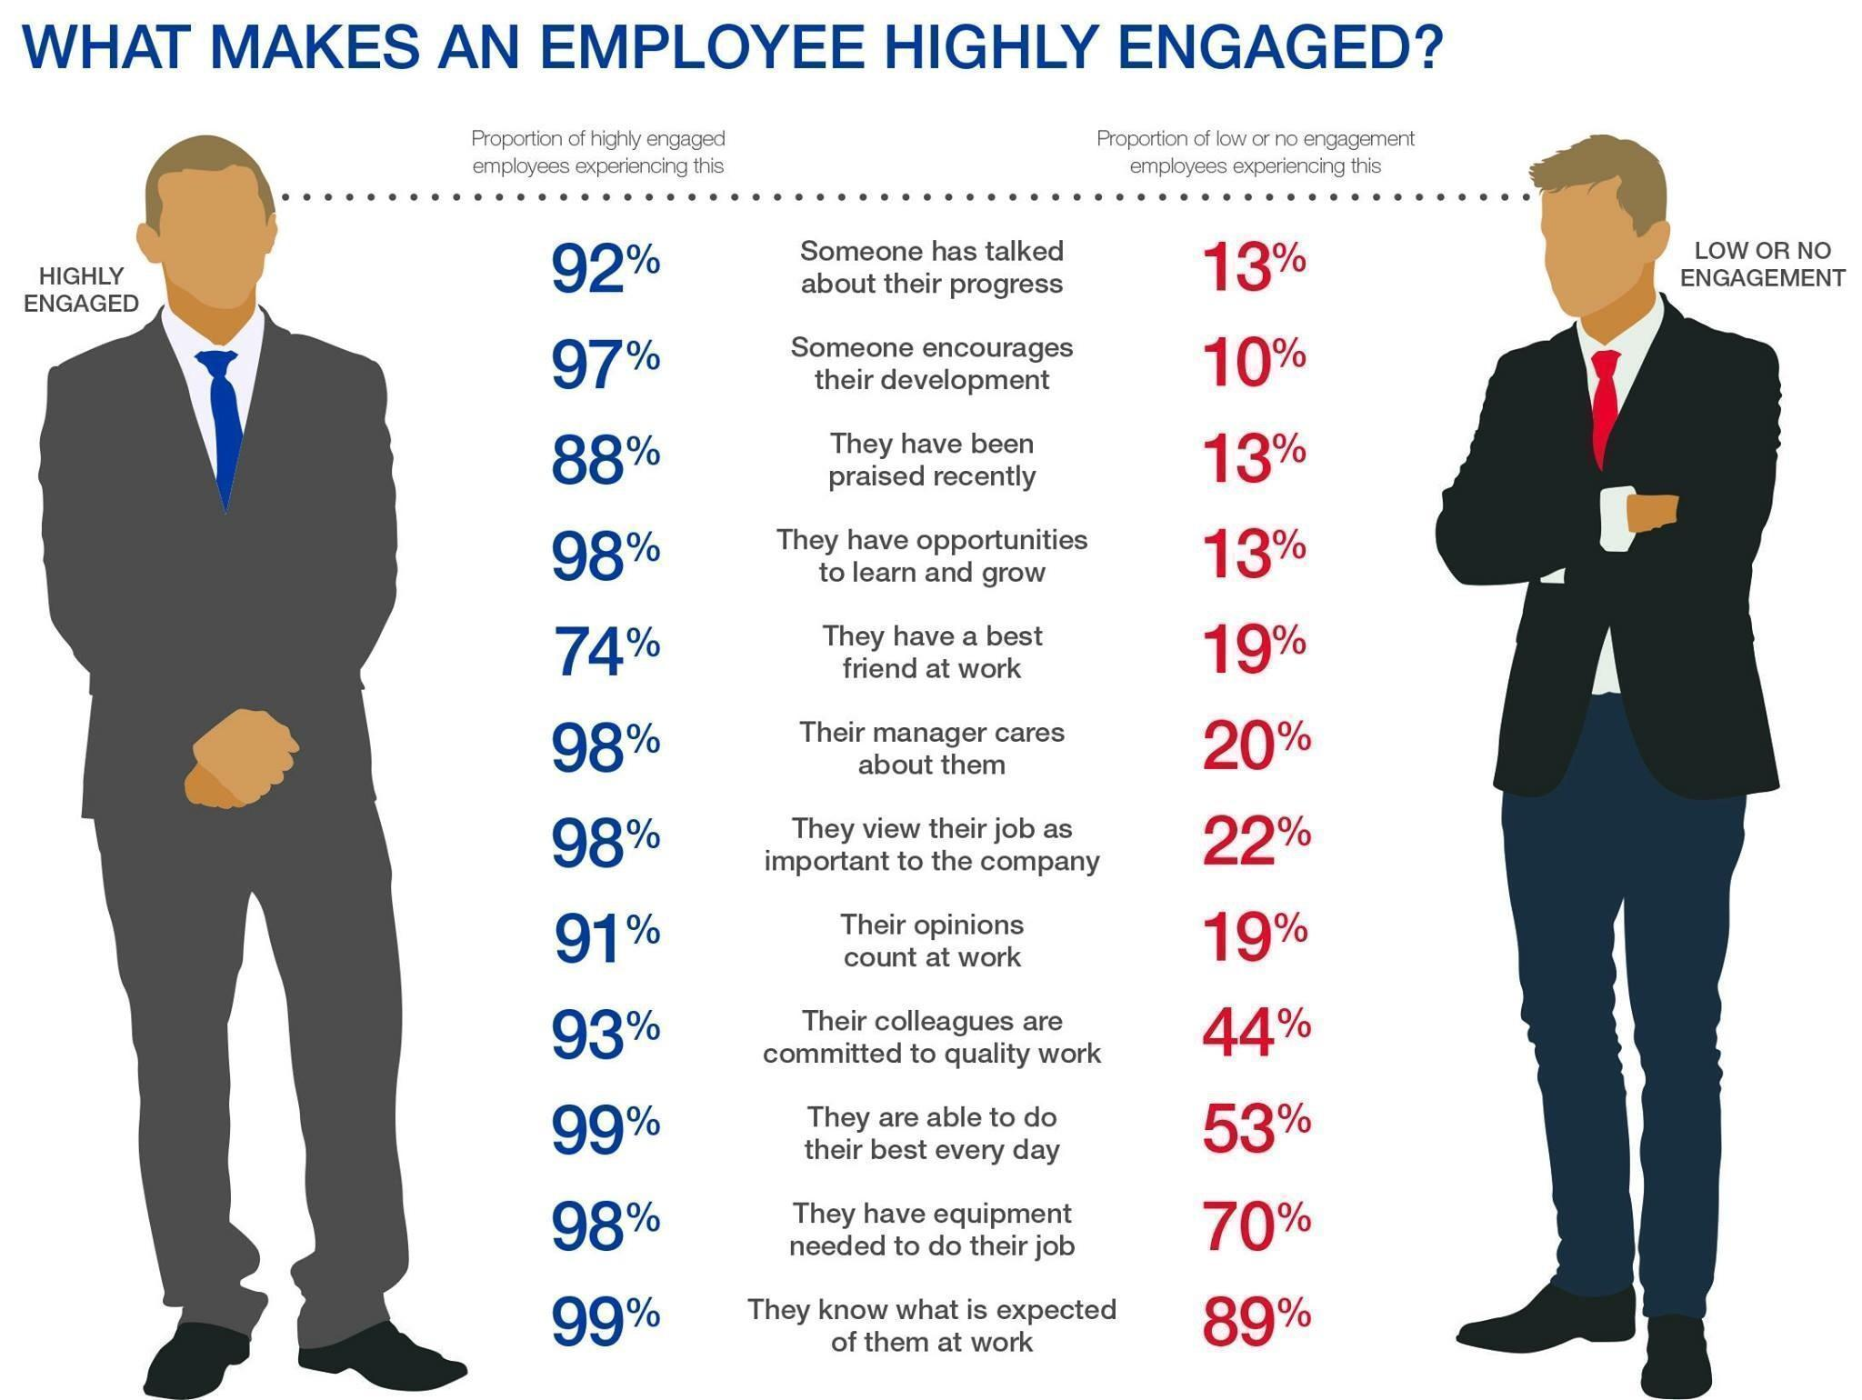
http://www.energi.uk.com/news/blog/What-Makes-An-Employee-Highly-Engaged-116

Slide 15
“People often say motivation doesn’t last. Neither does bathing—that’s why we recommend it daily.” – Zig Ziglar

